Slide 1
Error Detection
and
Correction

Slide 2
Data can be corrupted
during transmission.
Some applications require that
errors be detected and corrected.

Slide 3
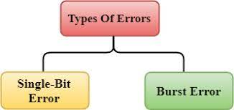

Types of Errors
Single-bit error
In a single-bit error, only 1 bit in the data unit has changed.

Slide 4

Burst error of length 8
A burst error means that 2 or more bits in the data unit have changed.

Slide 5

To detect or correct errors, we need to send extra (redundant) bits with data.
The structure of encoder and decoder

Slide 6
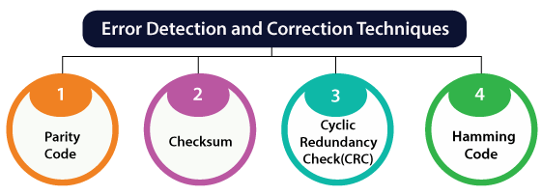

Slide 7
BLOCK CODING
In block coding, we divide our message into blocks, each of k bits, called datawords. We add r redundant bits to each block to make the length n = k + r. The resulting n-bit blocks are called codewords.

Slide 8

Datawords and codewords in block coding

Slide 9

Process of error detection in block coding

Slide 10

Structure of encoder and decoder in error correction

Slide 11
Hamming Code
Most common types of error-correcting codes used in RAM
devised by R. W. Hamming.
In the Hamming code, k parity bits are added to an n-bit data word, forming a new word of n +k bits. The bit positions are numbered in sequence from 1 to n + k.
Positions numbered with powers of two are reserved for the parity bits.(2⁰,2¹,2²,2³,2⁴..)
Remaining bits are the data bits.
2^r ≥ m + r + 1
where, r = redundant bit, m = data bit

Slide 12
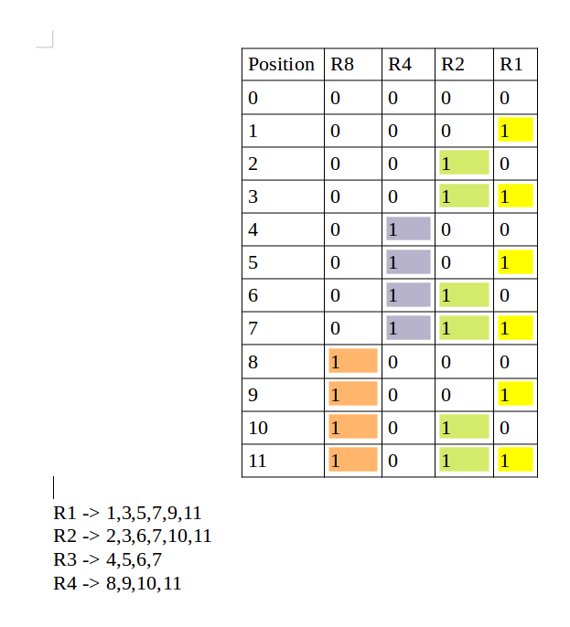
General Algorithm of Hamming code
Write the bit positions starting from 1 in binary form (1, 10, 11, 100, etc).
All the bit positions that are a power of 2 are marked as parity bits (1, 2, 4, 8, etc).
All the other bit positions are marked as data bits.
Each data bit is included in a unique set of parity bits, as determined its bit_position in binary form.
a. Parity bit 1 covers all the bits positions whose binary representation includes a 1 in the least significant position (1,3,5,7,9,11, etc).
b. Parity bit 2 covers all the bits positions whose binary representation includes a 1 in the second position from the least significant bit (2, 3, 6, 7, 10, 11, etc).
c. Parity bit 4 covers all the bits positions whose binary representation includes a 1 in the third position from the least significant bit (4–7, 12–15, 20–23, etc).
d. Parity bit 8 covers all the bits positions whose binary representation includes a 1 in the fourth position from the least significant bit bits (8–15, 24–31, 40–47, etc).
e. In general, each parity bit covers all bits where the bitwise AND of the parity position and the bit position is non-zero.
Since we check for even parity set a parity bit to 1 if the total number of ones in the positions it checks is odd.
Set a parity bit to 0 if the total number of ones in the positions it checks is even.

Slide 13
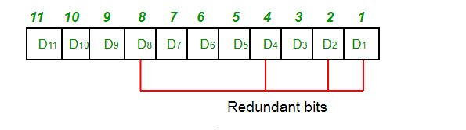
Determining the position of redundant bits
These redundancy bits are placed at the positions which correspond to the power of 2.
As in the above example:
The number of data bits = 7
The number of redundant bits = 4
The total number of bits = 11
The redundant bits are placed at positions corresponding to power of
2-> 1, 2, 4, and 8 (2^0, 2^1, 2^2, 2^3 …..)

Slide 14
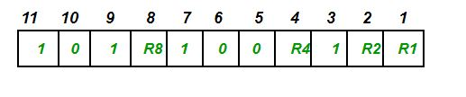
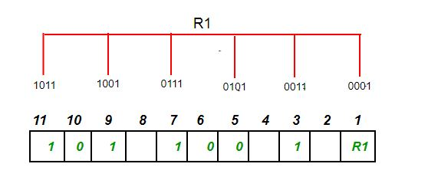
Suppose the data to be transmitted is 1011001, the bits will be placed as follows:
To find the redundant bit R1, we check for even parity. Since the total number of 1’s in all the bit positions corresponding to R1 is an even number the value of R1 (parity bit’s value) = 0
In the case of even parity, for a given set of bits, the number of 1's are counted. If that count is odd, the parity bit value is set to 1, making the total count of occurrences of 1's an even number. If the total number of 1's in a given set of bits is already even, the parity bit's value is 0.

Slide 15
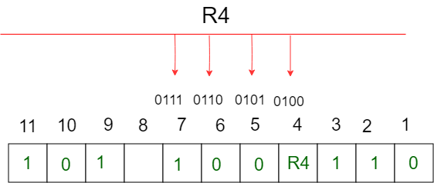
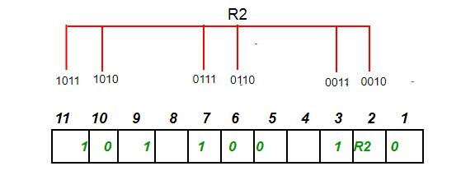
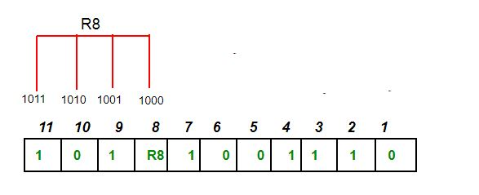


Slide 16
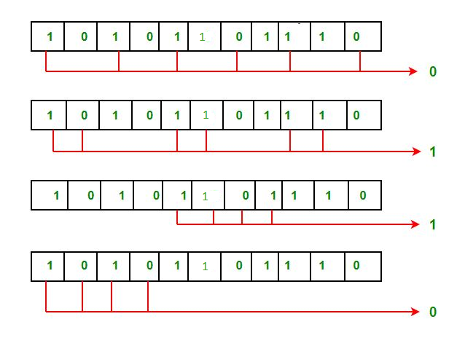
Suppose in the above example the 6th bit is changed from 0 to 1 during data transmission, then it gives new parity values in the binary number:
The bits give the binary number as 0110 whose decimal representation is 6. Thus, the bit 6 contains an error. To correct the error the 6th bit is changed from 1 to 0.

Slide 17
Give the Hamming code for the data bits 01001000111 using odd parity.
Give the Hamming code for the data bits 10011011100 using odd parity.
Data sent: 1 0 0 1 1 1 0 0 1 0 1
Data received: 1 00 1 0 1 00 1 0 1

Slide 18
LINEAR BLOCK CODES
Almost all block codes used today belong to a subset called linear block codes.
A linear block code is a code in which the exclusive OR (addition modulo-2) of two valid codewords creates another valid codeword.

Slide 19
CYCLIC CODES
Cyclic codes are special linear block codes with one extra property. In a cyclic code, if a codeword is cyclically shifted (rotated), the result is another codeword.

Slide 20
Cyclic Redundancy Check (CRC)

Slide 21

A CRC code with C(7, 4)

Slide 22

CRC encoder and decoder

Slide 23
CRC calculation:
A string of n as is appended to the data unit. The length of predetermined divisor is n+1.
The newly formed data unit i.e. original data + string of n as are divided by the divisor using binary division and remainder is obtained. This remainder is called CRC.
Now, string of n 0s appended to data unit is replaced by the CRC remainder (which is also of n bit).
The data unit + CRC is then transmitted to receiver.
The receiver on receiving it divides data unit + CRC by the same divisor & checks the remainder.
If the remainder of division is zero, receiver assumes that there is no error in data and it accepts it.
If remainder is non-zero then there is an error in data and receiver rejects it.

Slide 24
Data word : 1001
Divisor : 1011
Code word : Data word + Remainder

Slide 25

Division in CRC encoder

Slide 26

Division in the CRC decoder for two cases

Slide 27

A polynomial to represent a binary word

Slide 28

CRC division using polynomials

Slide 29
Given the dataword 1010011110 and the divisor 10111,
Show the generation of the codeword at the sender site (using binary division).
What is the syndrome at the receiver end if the dataword has an error in the 5 th bit position counting from the right? Namely: dataword 1010001110 is received? How does the receiver know that an error has occurred?

Slide 31
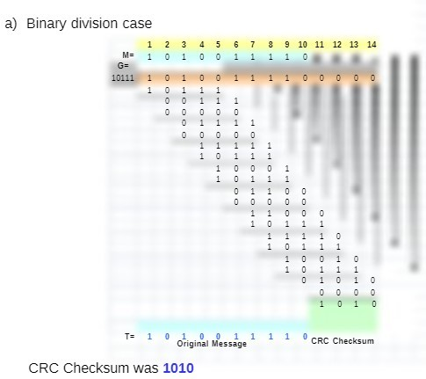

Slide 32
A Frame 1101011011 is transmitted using CRC method. The generator polynomial is X^4 + X +1. Show the actual bit string transmitted. Suppose the third bit from the left is inverted during transmission show that this error is detected at the receivers side.

Slide 33
Backward error correction and Forward error correction:
Error Correction can be handled in two ways:
Backward error correction:
  Once the error is discovered, the receiver requests the sender to retransmit the entire data unit.
Forward error correction:
  In this case, the receiver uses the error-correcting code which automatically corrects the errors.

Slide 34
LINEAR BLOCK CODES
Almost all block codes used today belong to a subset called linear block codes.
A linear block code is a code in which the exclusive OR (addition modulo-2) of two valid codewords creates another valid codeword.
A simple parity-check code is a
single-bit error-detecting
code in which
n = k + 1 with d_{min} = 2.

Slide 35
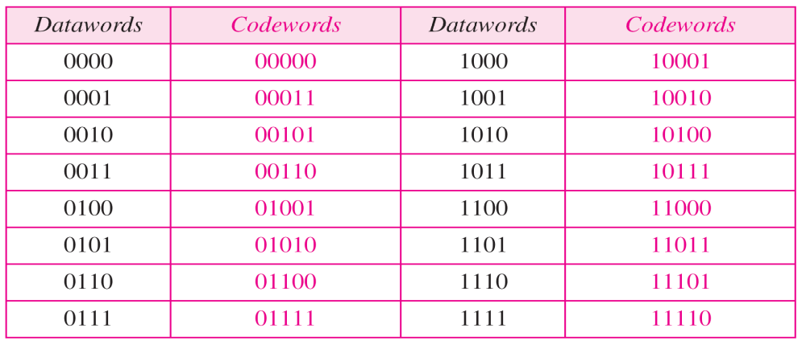
Simple parity-check code C(5, 4)

Slide 36

Encoder and decoder for simple parity-check code

Slide 37
Let us look at some transmission scenarios. Assume the sender sends the dataword 1011. The codeword created from this dataword is 10111, which is sent to the receiver. We examine five cases:
No error occurs; the received codeword is 10111. The syndrome is 0. The dataword 1011 is created.
2. One single-bit error changes a₁ . The received codeword is 10011. The syndrome is 1. No dataword is created.
3. One single-bit error changes r₀ . The received codeword is 10110. The syndrome is 1. No dataword is created.
4. An error changes r₀ and a second error changes a₃ .The received codeword is 00110. The syndrome is 0. The dataword 0011 is created at the receiver. Note that here the dataword is wrongly created due to the syndrome value.
5. Three bits—a₃, a₂, and a₁—are changed by errors. The received codeword is 01011. The syndrome is 1. The dataword is not created. This shows that the simple parity check, guaranteed to detect one single error, can also find any odd number of errors.

Slide 38

A simple parity-check code can detect an odd number of errors.
Two-dimensional parity-check code

Slide 39

Two-dimensional parity-check code

Slide 40

Two-dimensional parity-check code

Slide 41
CHECKSUM
The last error detection method is called the checksum. The checksum is used in the Internet by several protocols although not at the data link layer.
IP Header, TCP Header and UDP Header.

Slide 42
Sender site:
1. The message is divided into 16-bit words / 8-bit words.
2. The value of the checksum word is set to 0.
3. All words including the checksum are added using one’s complement addition.
4. The sum is complemented and becomes the checksum.
5. The checksum is sent with the data.

Slide 43
Receiver site:
1. The message (including checksum) is divided into 16-bit words / 8 bit words.
2. All words are added using one’s complement addition.
3. The sum is complemented and becomes the new checksum.
4. If the value of checksum is 0, the message is accepted; otherwise, it is rejected.

Slide 44
Consider the data unit to be transmitted is-
10011001111000100010010010000100
Consider 8 bit checksum is used.

Slide 45
Now, all the segments are added and the result is obtained as-
10011001 + 11100010 + 00100100 + 10000100 = 1000100011
Since the result consists of 10 bits, so extra 2 bits are wrapped around.
00100011 + 10 = 00100101 (8 bits)
Now, 1’s complement is taken which is 11011010.
Thus, checksum value = 11011010

Slide 46
At receiver side,
The received data unit is divided into segments of 8 bits.
All the segments along with the checksum value are added.
Sum of all segments + Checksum value = 00100101 + 11011010 = 11111111
Complemented value = 00000000
Since the result is 0, receiver assumes no error occurred in the data and therefore accepts it.

Slide 47
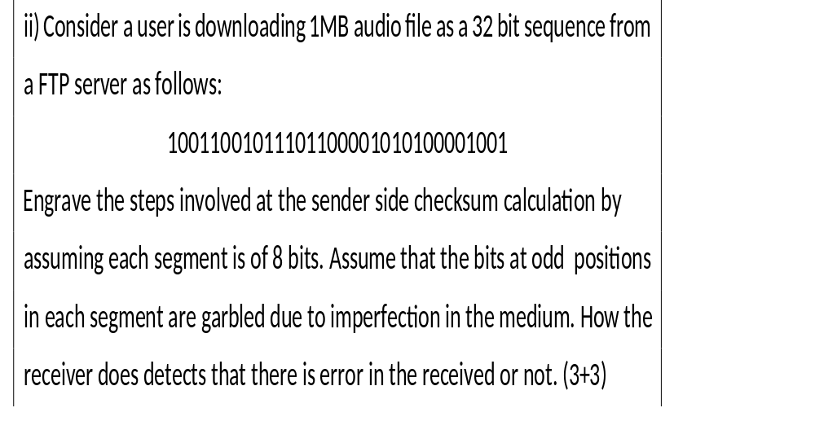

Slide 48
10011001011101100001010100001001
Sender:
S1 : 10011001
S2 : 01110110
S3 : 00010101
S4 : 00001001 Sum: 11110011
Sender checksum :00001100 Sender data : 1001100101110110000101010000100100001100
Received data : 1100110000100011010000000101110000001100
Receiver side calculation:
S1 : 11001100
S2 : 00100011
S3 : 01000000
S4 : 01011100
S5 : 01011001
Sum: 10101010 Receiver checksum: 01010101 <=not equal to zero

Slide 49
Suppose that a message 1001 1100 1010 0011 is transmitted using Internet Checksum (4-bit word). What is the value of the checksum?

